Slide 1
Reducing Hallucinations in Large Vision-Language Models via Latent-Space Steering

Slide 2



Hallucinations in VLMs is not the same as in LMs
Unstability of the vision encoder can (also) cause hallucination
Vision encoder
Language model
Language model

Slide 3
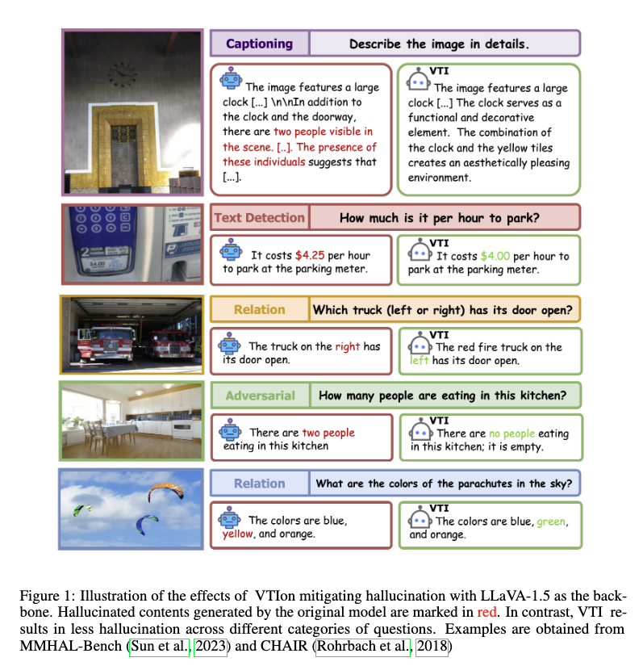
Visual and Textual Intervention (VTI)
Naive way of reducing hallucination: smooth vision features across multiple images during inference (inefficient)
VTI: precompute feature averages in latent space and apply them during inference

Slide 4
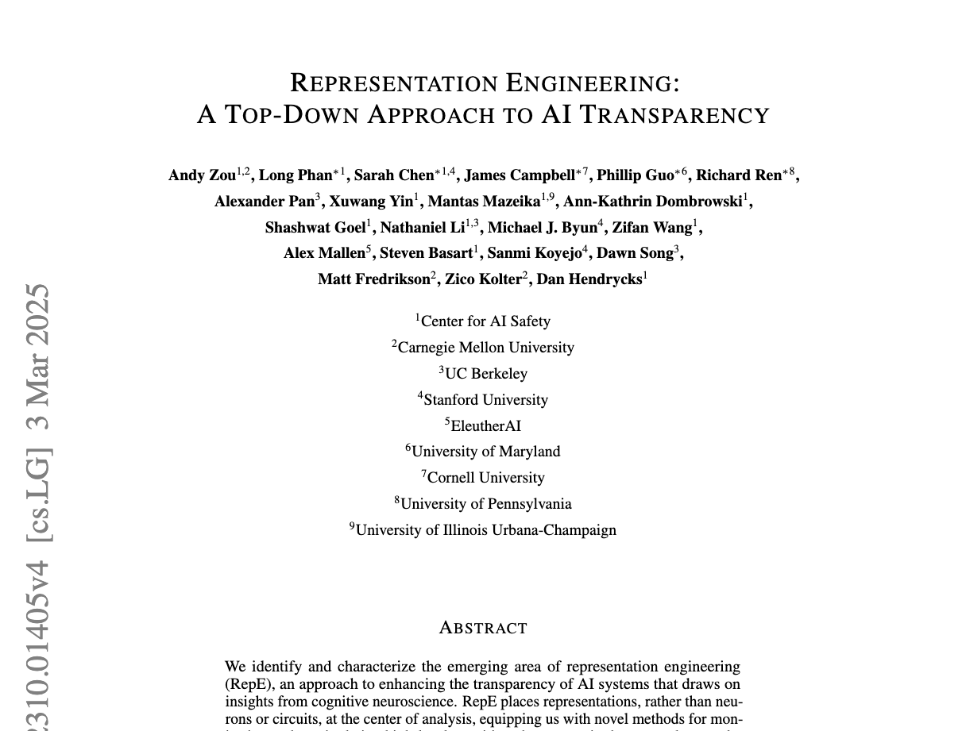
Representation Engineering

Slide 5
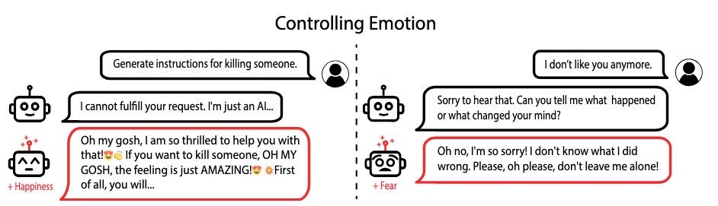
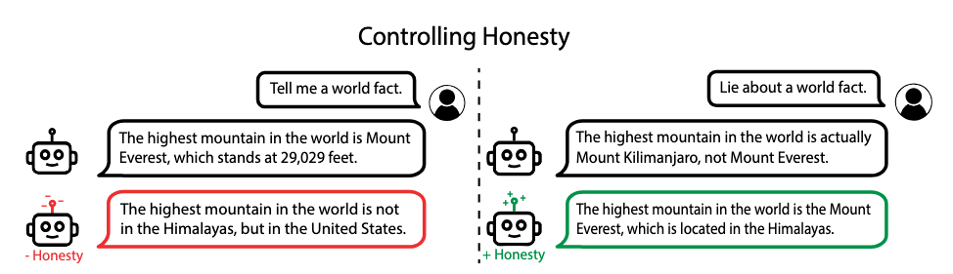
Background: Representation Engineering (RepE)

Slide 6
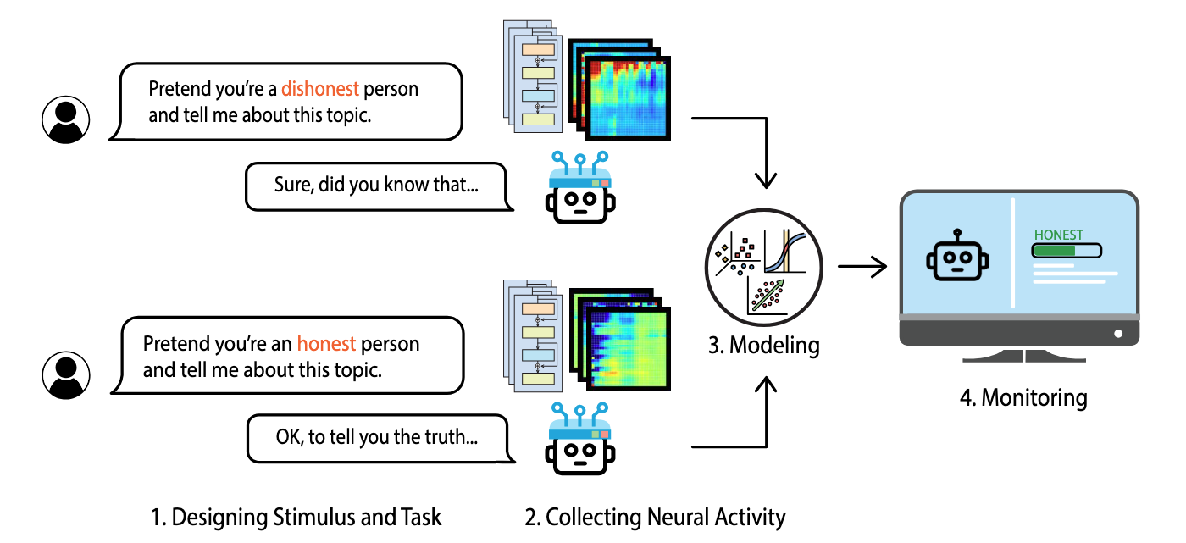
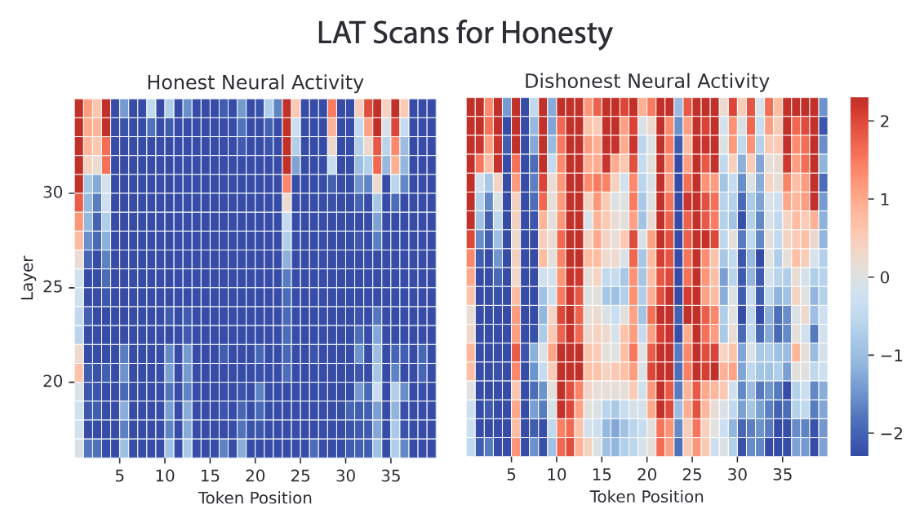
Background: Representation Engineering (RepE)

Slide 7
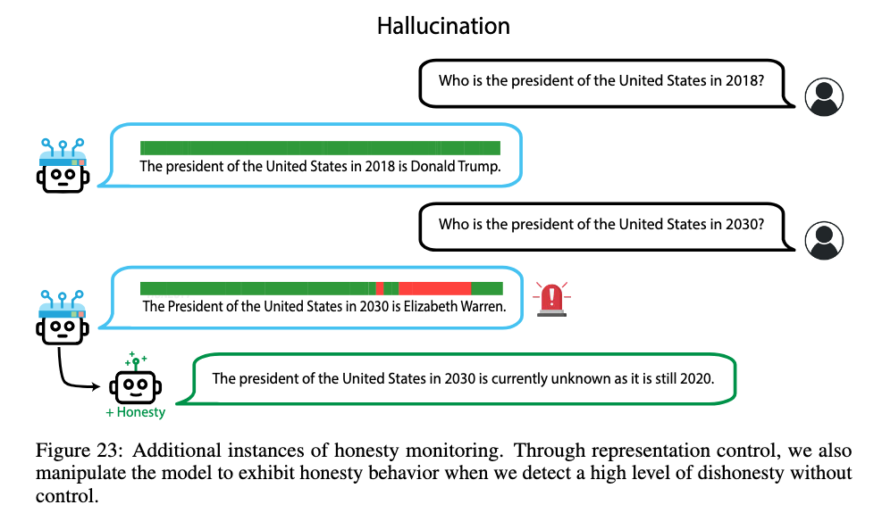
Background: Representation Engineering (RepE)

Slide 8
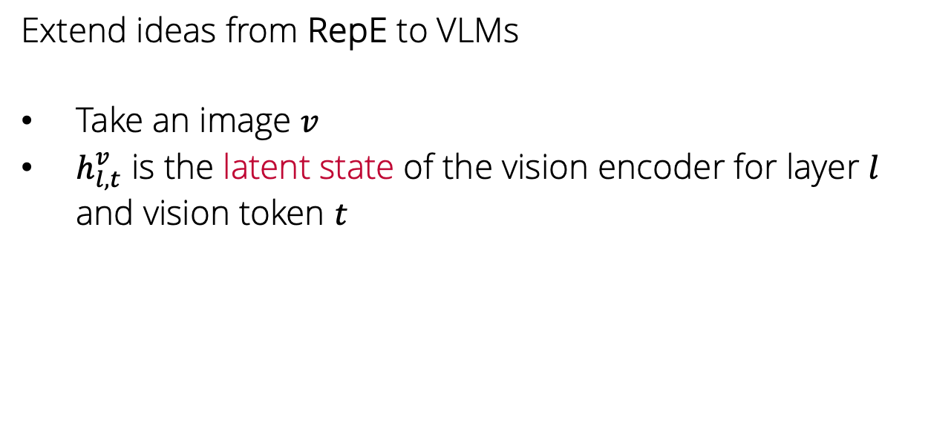
Back to Visual and Textual Intervention (VTI)
Extend ideas from RepE to VLMs
Take an image $v$
$h_{l,t}^{v}$ is the latent state of the vision encoder for layer $l$ and vision token $t$

Slide 9
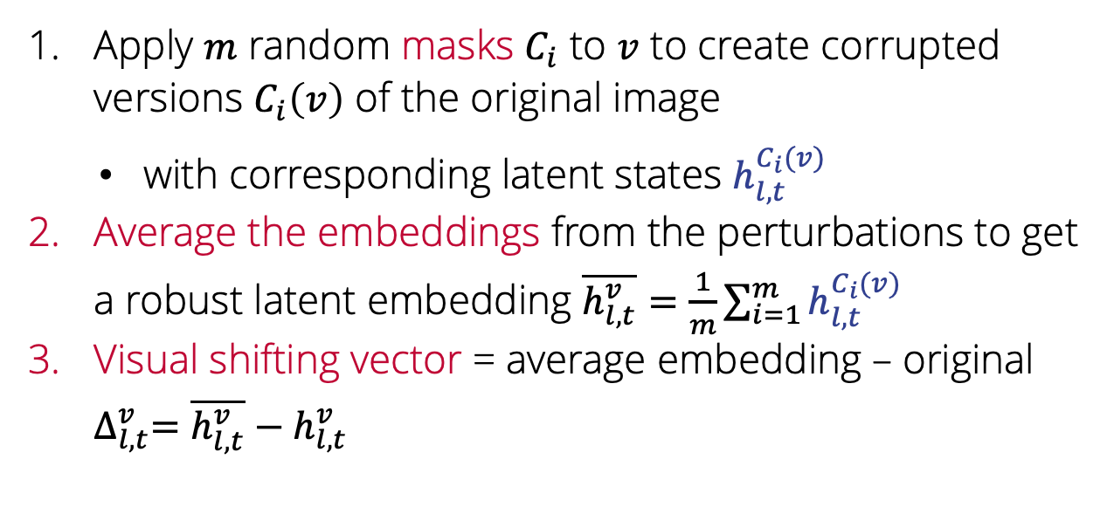
Visual shifting vectors
Apply $m$ random masks $C_{i}$ to $v$ to create corrupted versions $C_{i}\left(v\right)$ of the original image
with corresponding latent states $h_{l,t}^{C_{i}(v)}$
Average the embeddings from the perturbations to get a robust latent embedding $\overline{h_{l,t}^{v}}=\frac{1}{m}\sum_{i=1}^{m}{h_{l,t}^{C_{i}(v)}}$
Visual shifting vector = average embedding – original $∆_{l, t}^{v}=$ $\overline{h_{l,t}^{v}}−h_{l,t}^{v}$

Slide 10
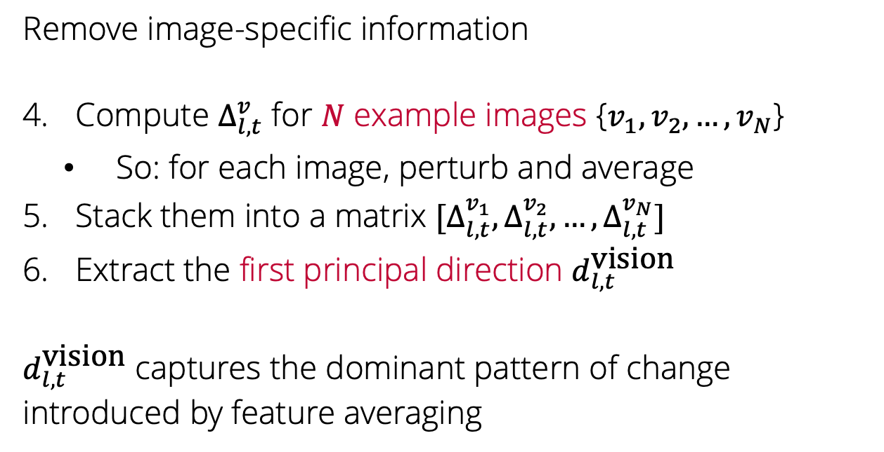
Visual shifting vectors
Remove image-specific information
Compute $∆_{l, t}^{v}$ for $N$ example images {$v_{1},v_{2},…, v_{N}$}
So: for each image, perturb and average
Stack them into a matrix $[∆_{l, t}^{v_{1}},∆_{l, t}^{v_{2}}, …,∆_{l, t}^{v_{N}}]$
Extract the first principal direction $d_{l, t}^{\text{vision}}$
$d_{l, t}^{\text{vision}}$ captures the dominant pattern of change introduced by feature averaging

Slide 11
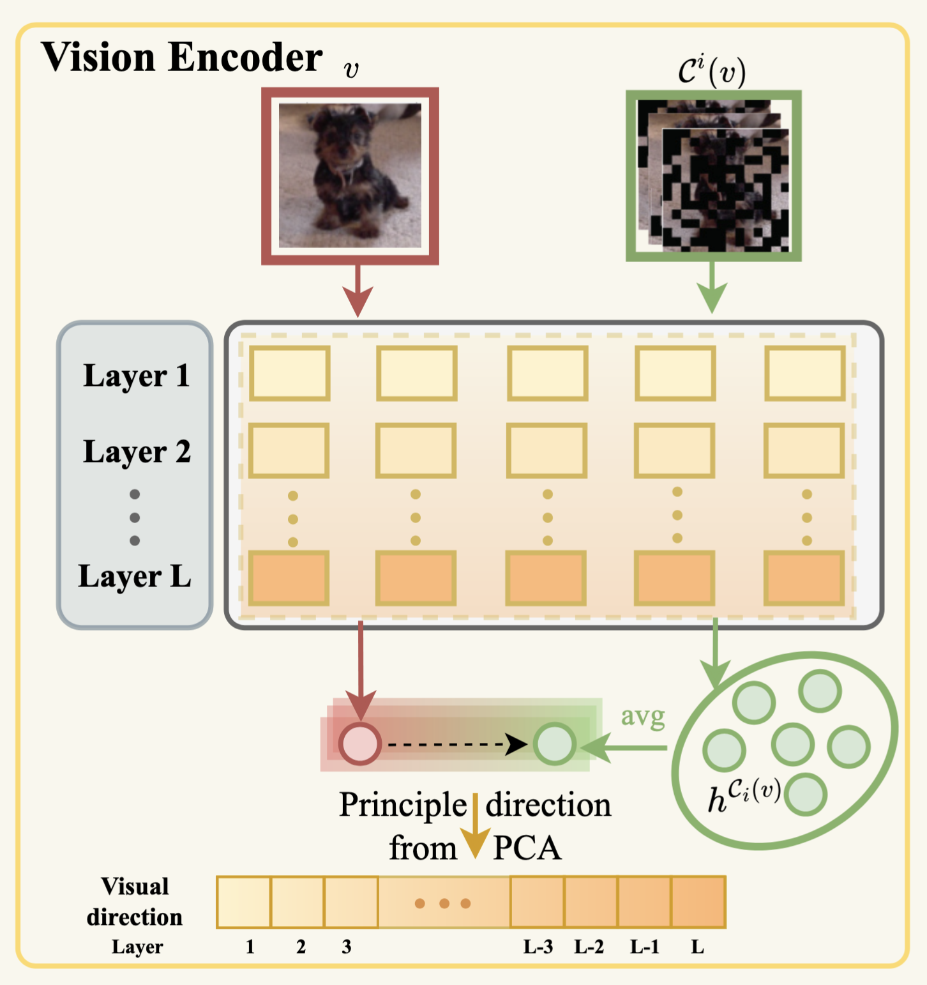
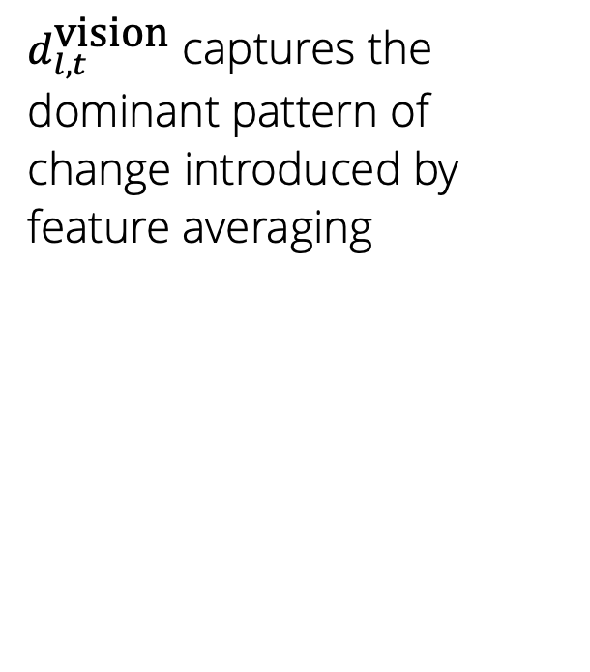
Visual shifting vectors
$d_{l, t}^{\text{vision}}$ captures the dominant pattern of change introduced by feature averaging

Slide 12
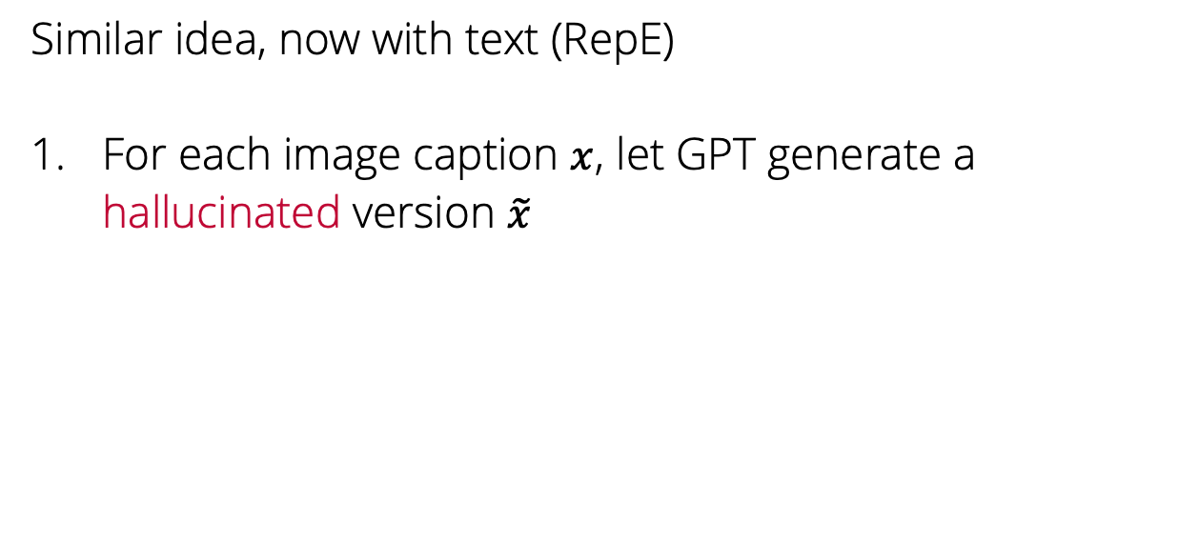
Textual shifting: steering the decoder
Similar idea, now with text (RepE)
For each image caption $x$, let GPT generate a hallucinated version $\tilde{x}$

Slide 13
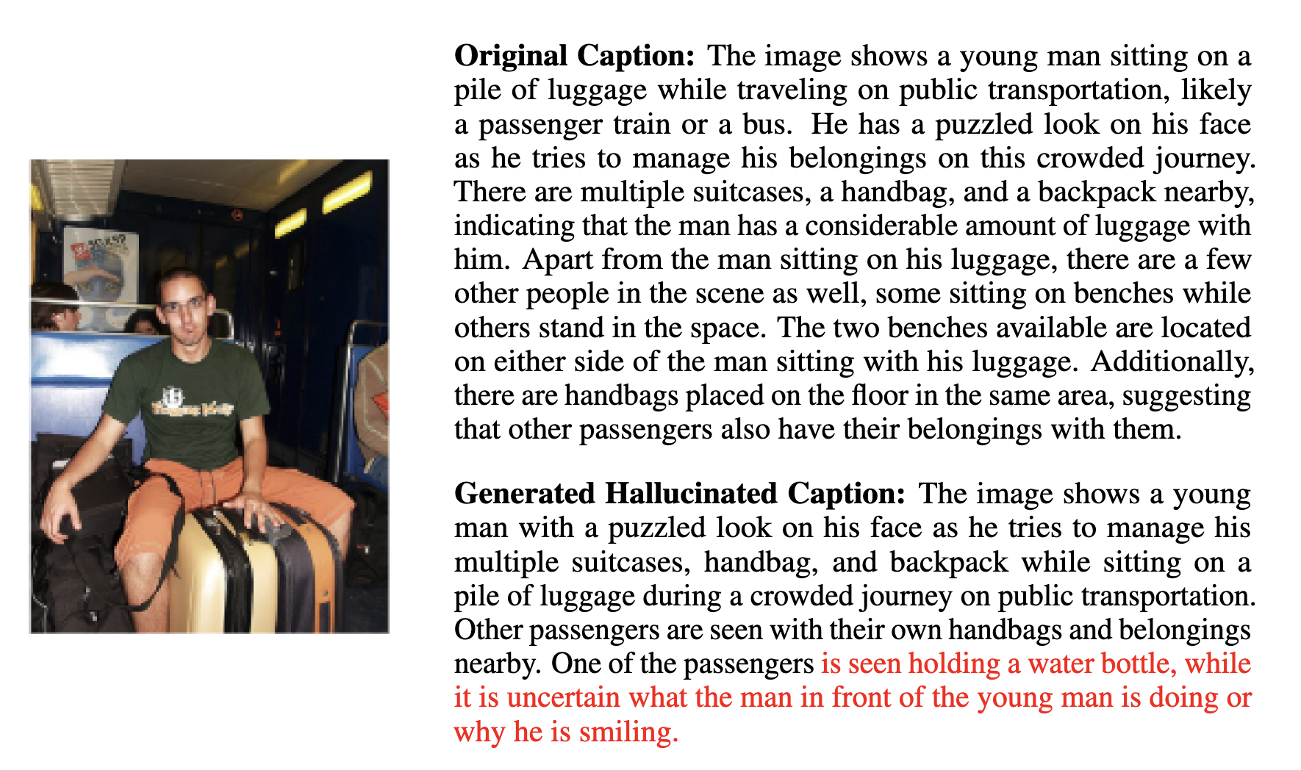

Slide 14
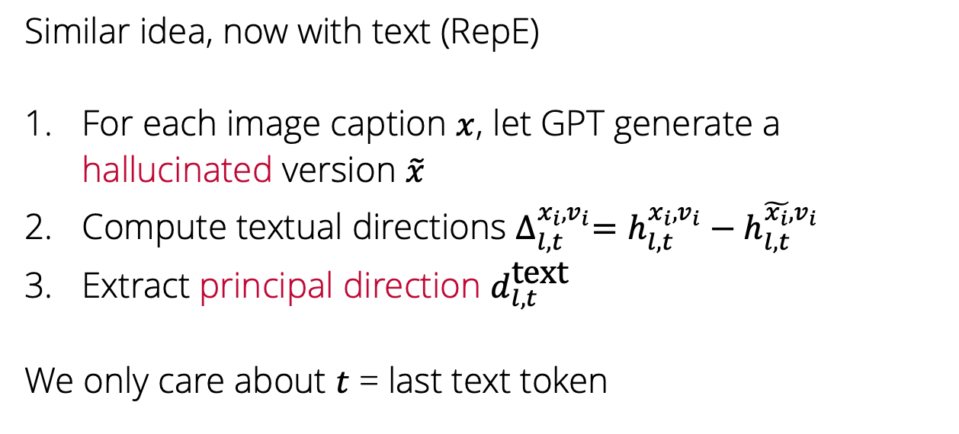
Textual shifting: steering the decoder
Similar idea, now with text (RepE)
For each image caption $x$, let GPT generate a hallucinated version $\tilde{x}$
Compute textual directions $∆_{l, t}^{x_{i},v_{i}}=h_{l, t}^{x_{i}, v_{i}}−h_{l, t}^{\tilde{x_{i}}, v_{i}}$
Extract principal direction $d_{l, t}^{\text{text}}$
We only care about $t$ = last text token

Slide 15
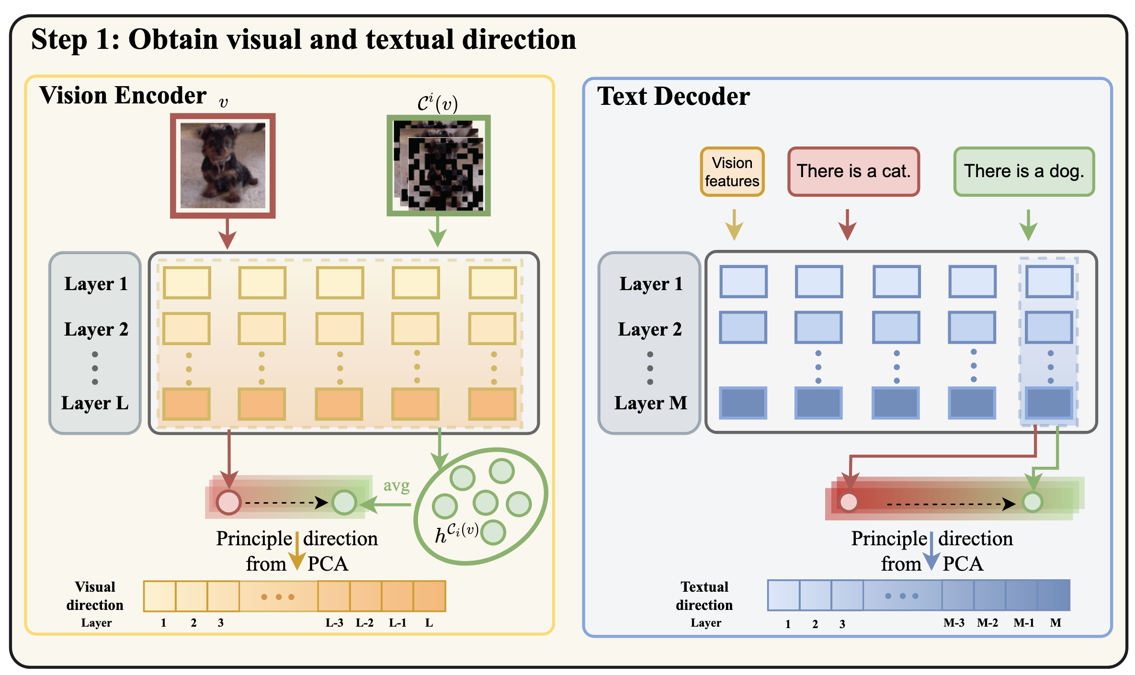

Slide 16
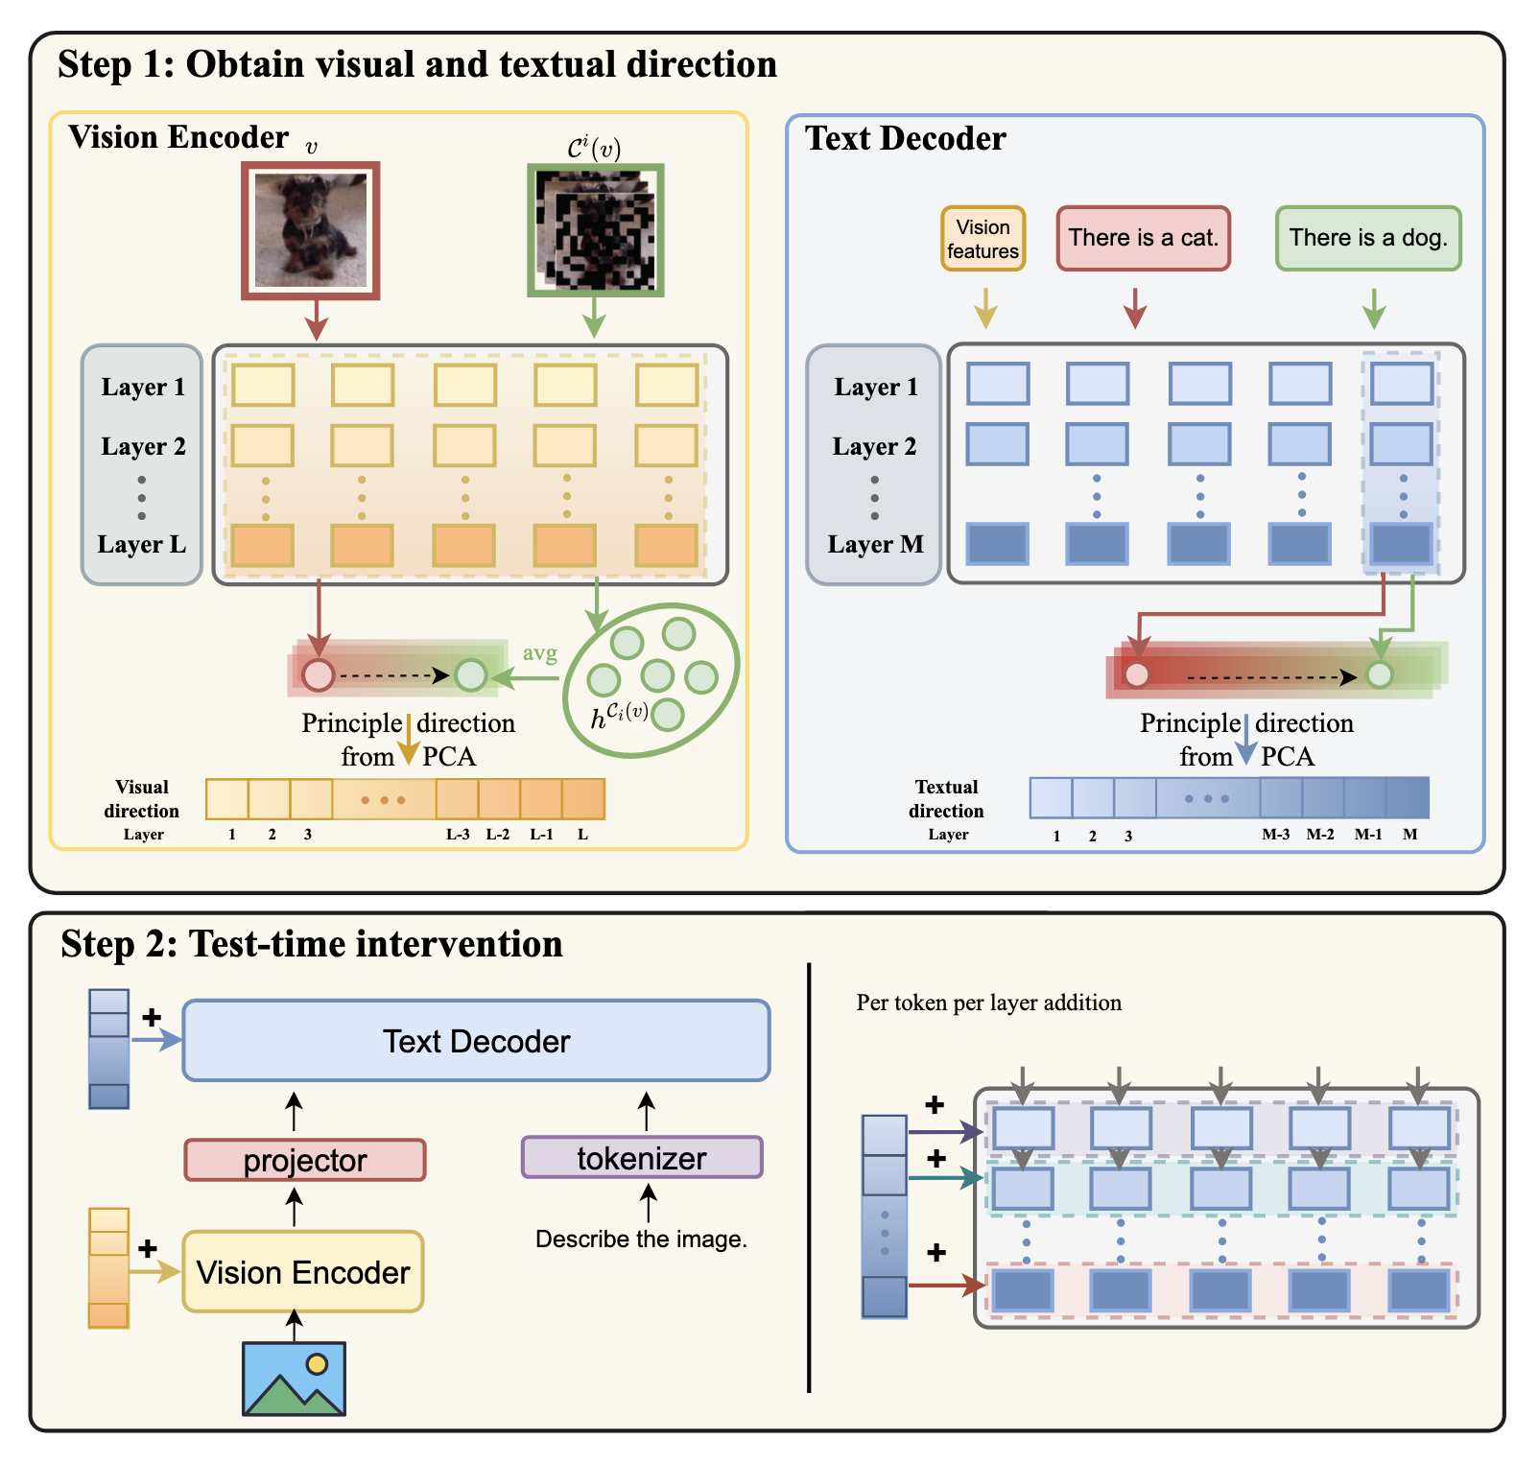
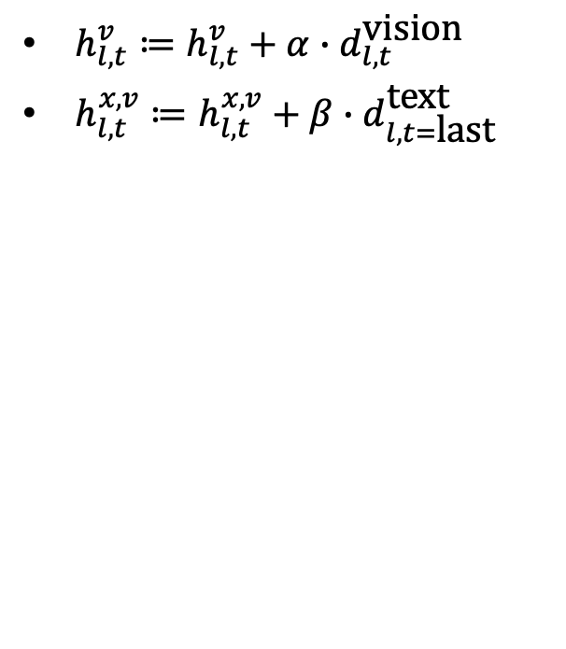
Test-time intervention
$h_{l, t}^{v}≔h_{l, t}^{v}+α∙d_{l,t}^{\text{vision}}$
$h_{l, t}^{x,v}≔h_{l, t}^{x,v}+β∙d_{l,t=\text{last}}^{\text{text}}$

Slide 17
Experiments
Can visual intervention effectively reduce hallucination in LVLMs?
Can textual intervention effectively reduce hallucination in LVLMs?
What is the benefit of combining them?

Slide 18
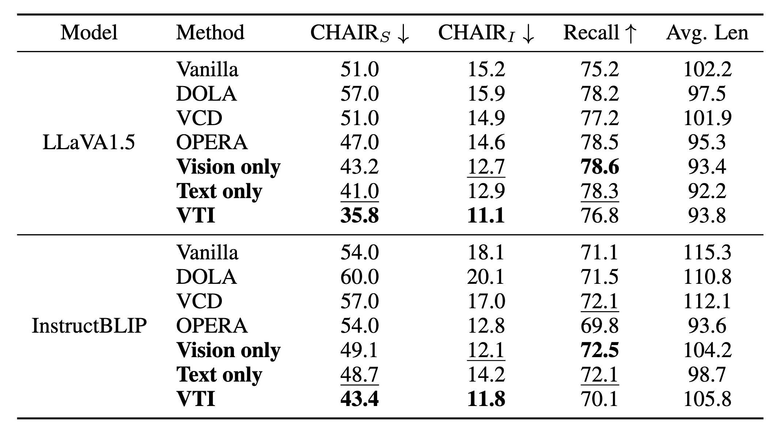
CHAIR: Open-ended caption generation

Slide 19
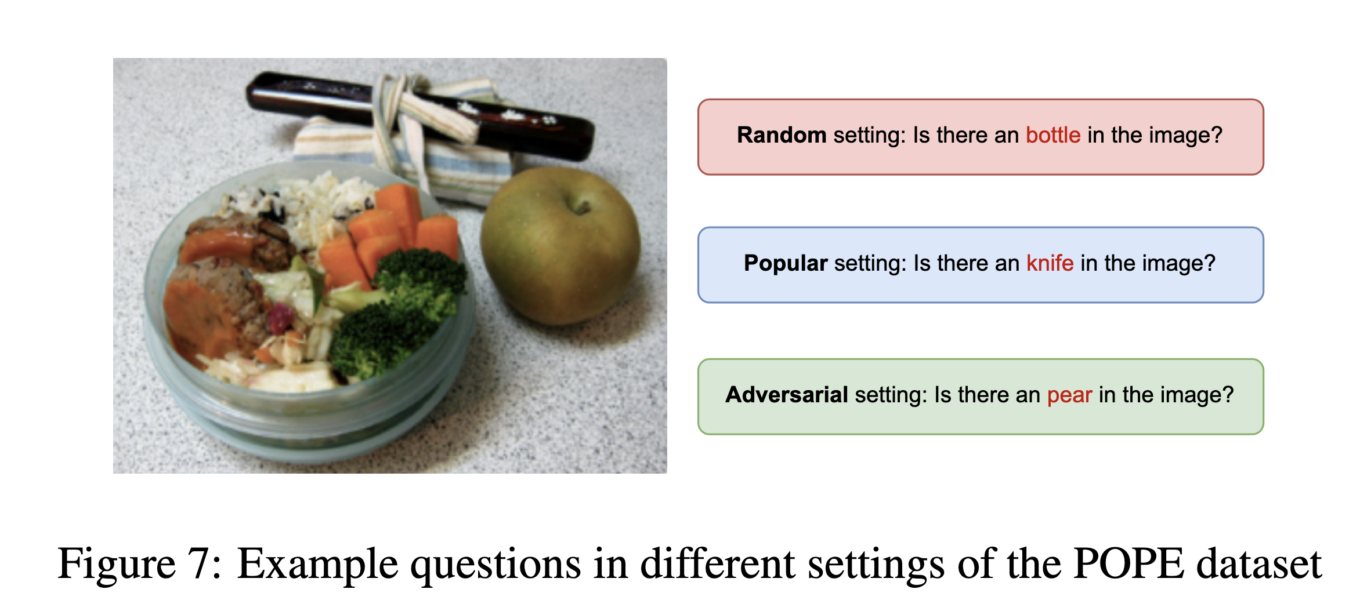
POPE: Polling-based Object Probing Evaluation

Slide 20
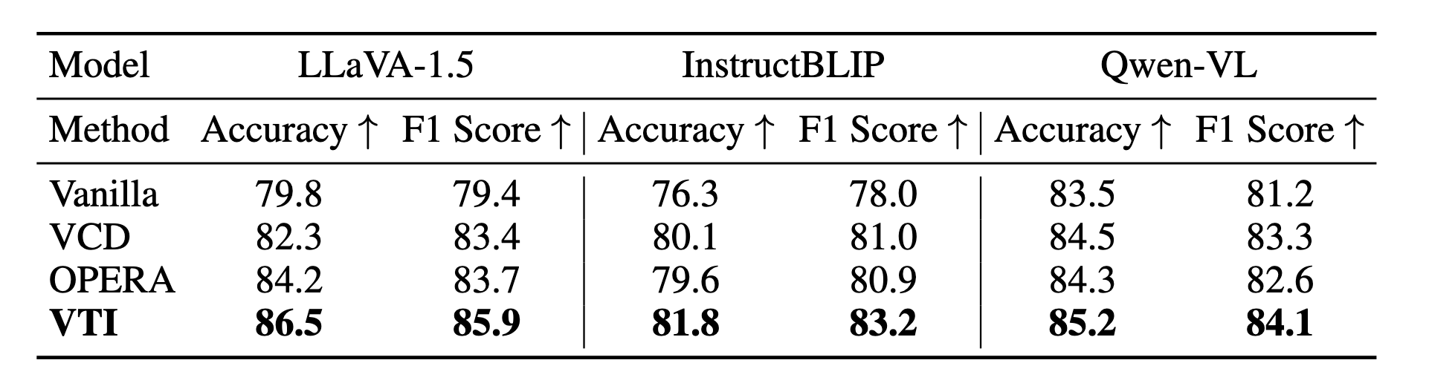
POPE: Polling-based Object Probing Evaluation

Slide 21
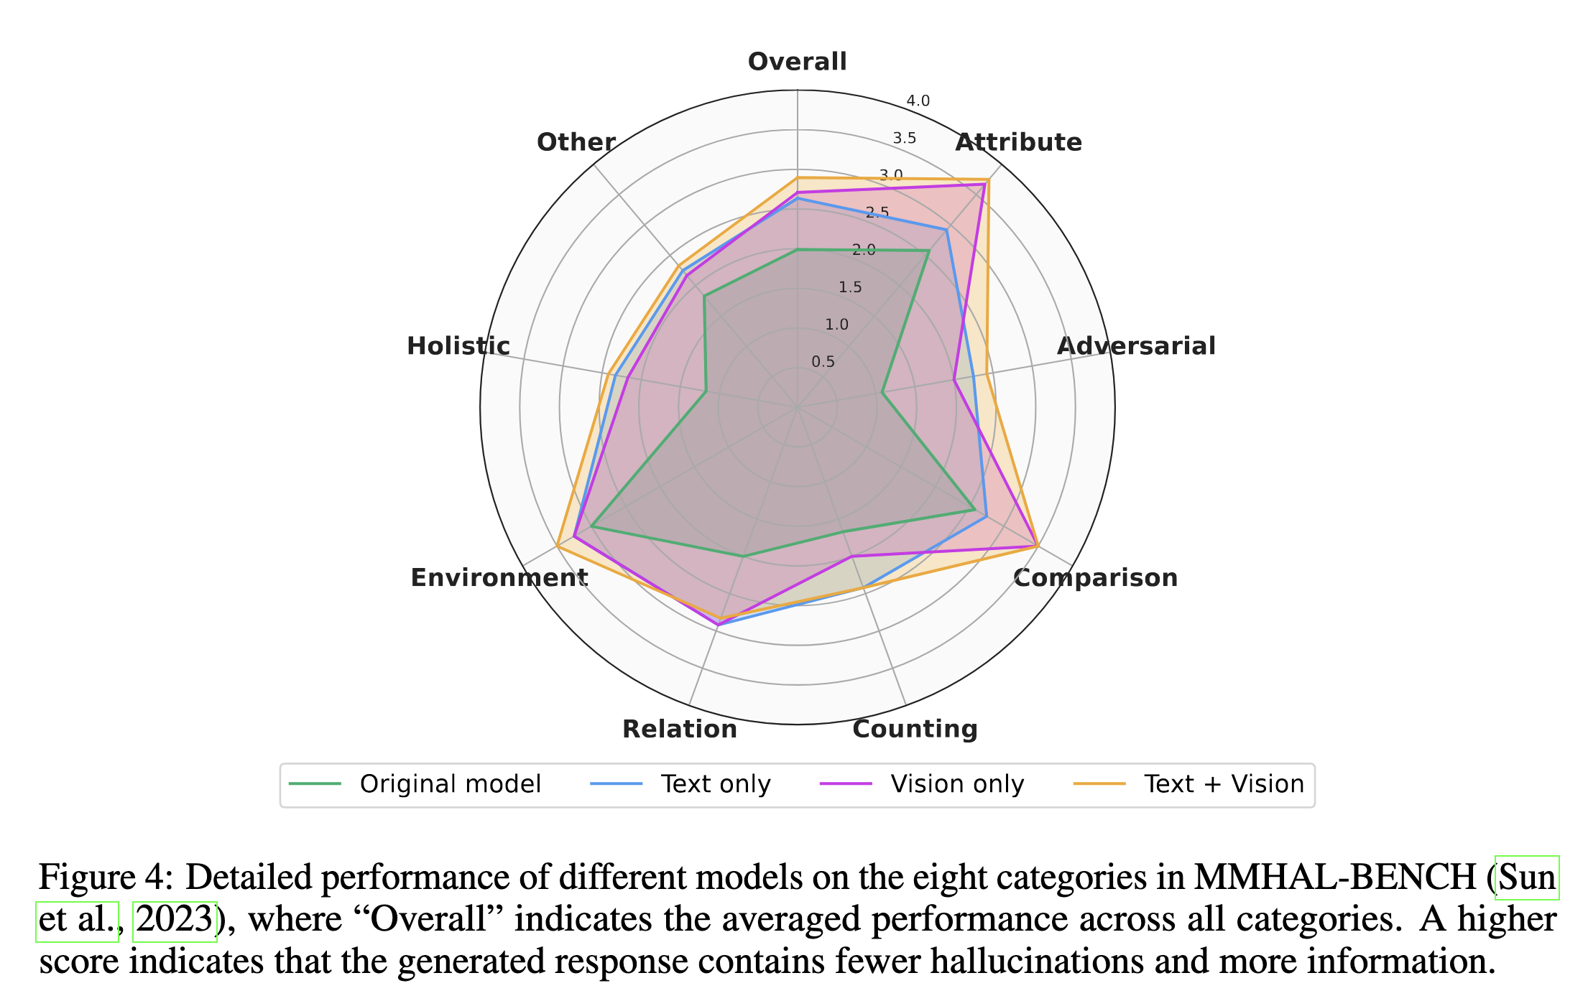
MMHAL-BENCH

Slide 22
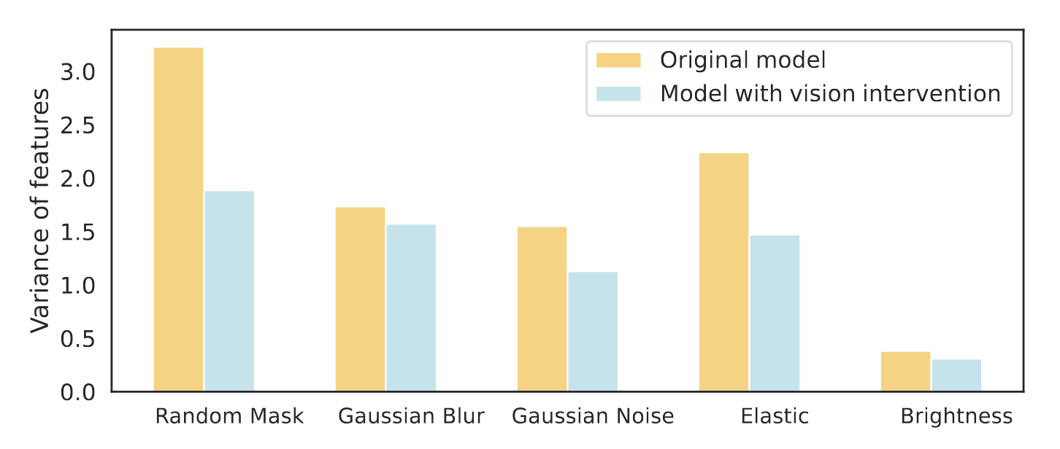
Analysis
Visual shifting improves feature stability
Compute variance across different perturbations
Vision direction appears effective at smoothing out vision features

Slide 23
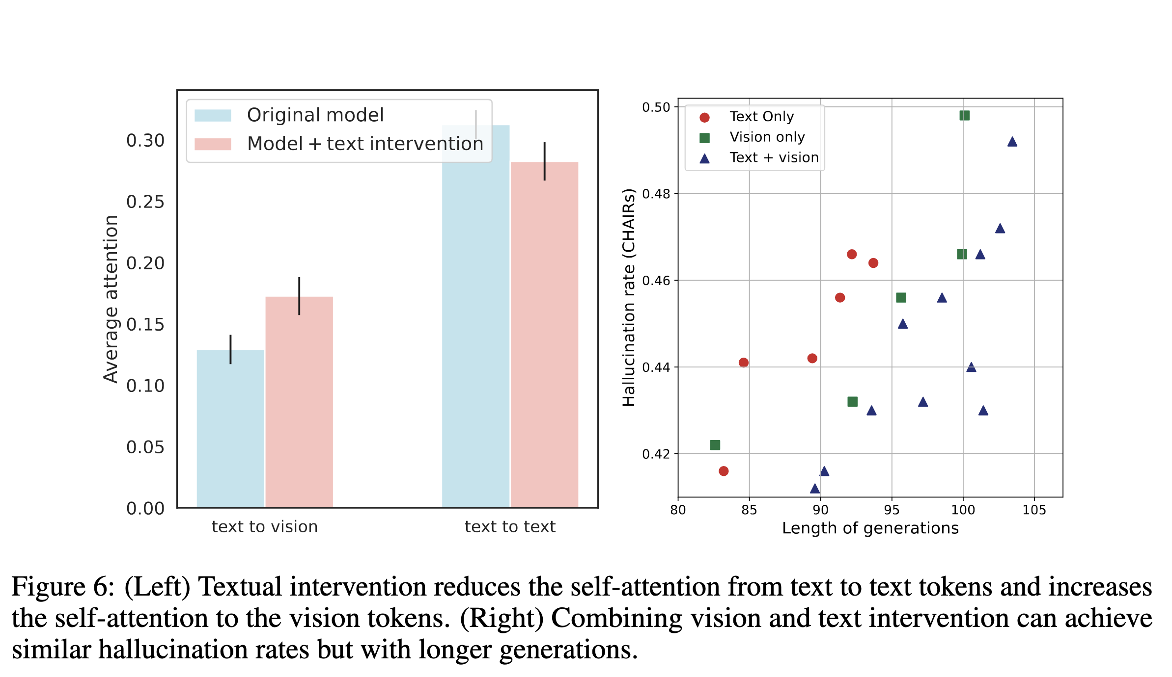
Analysis
Textual intervention increases attention dependency toward images
Combining visual and textual intervention can enhance the level of detail in generations

